Slide 1
Diagnostic Test Generation for Path Delay Faults in a Scan Circuit
Master’s Thesis Defense
Zeshi Luo
Department of Electrical and Computer Engineering
Thesis Advisor: Dr. Vishwani D. Agrawal
Committee Members:
Dr. Adit D. Singh, Dr. Victor P. Nelson,
May 20, 2015

Slide 2
Outline
Background
Problem statement and motivation
Contribution
Diagnostic ATPG system
-Path delay fault detection
-Modeling a path delay fault
-Detection test
-Exclusive test
Experimental setup and results
Conclusion
Future work
References

Slide 3
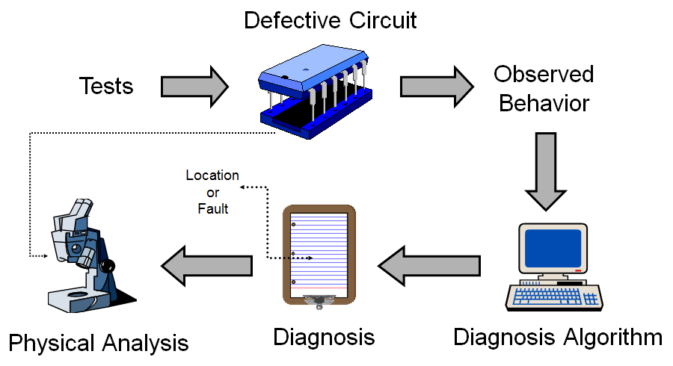
Background
Flowchart of fault diagnosis
Notes:
The process of Fault diagnosis is shown in the picture. We apply test vectors to the defective circuit. And then the observed behavior will be analyzed by the computer. The diagnosis algorithm will give us a diagnosis report about the location of fault. Physical analysis is implemented by the optical telescope or other advanced equipments . Finally, we will try to locate the fault and find the reason in defective circuit.

Slide 4
Basic concepts
The unit under test (UUT) fails when observed behavior is different from its expected behavior.
Locating the physical fault(s) in a structural model of the UUT.
Functionally equivalent faults (FEF) cannot be distinguished.
A test that achieves the maximal fault resolution is a complete fault-location test.
Notes:
A unit under test (UUT) fails when its observed behavior is different from its expected behavior. Diagnosis consists of locating the physical fault(s) in a structural model of the UUT. The degree of accuracy to which faults can be located is called the resolution of diagnosis. Functionally equivalent faults (FEF) cannot be distinguished. The partition of all faults into distinct subsets of FEF defines the maximal fault resolution. A test that achieves the maximal fault resolution is said to be a complete fault-location test.

Slide 5
Effect-cause algorithm
Step 1: Trace fan-in cones from the failing primary outputs to make a list of suspected faults.
Step 2: Simulate the suspect faults and perform analysis.
Step 3: Rank faults according to how a fault explains failing responses.
Step 4: Remove the low ranking suspects and compress the fault list.
Notes:
po

Slide 6
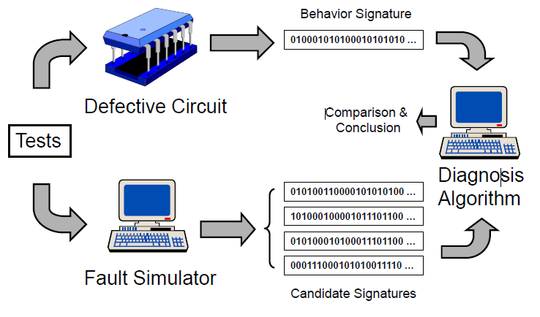
Cause-effect algorithm
Obtain fault simulator and defective circuit responses.
Comparison and conclusion from computer.
Process of cause-effect algorithm
Notes:
Fault simulator will model the behavior of fault model. It generates candidate signatures of fault. Test are also applied to detect the faults in real circuits. The behavior signature of defective circuit will be compared with them from fault simulator. Comparison and conclusion will be made then.

Slide 7
Fault diagnosis requirement
1. Need at least one vector that produces different responses for every pair of faults.
2. A guess as to what’s wrong with a malfunctioning circuit.
3. Narrow down the search for physical root cause.
4. It’s usually based on the logical operation of the circuit.

Slide 8
Testing versus diagnosis
Testing: Apply test vectors to detect target fault in the circuit. Make conclusions on whether the circuit functions normally.
Diagnosis: Apply test vectors in order to produce different output responses for every pair of faults.

Slide 9
Problem statement
Given a benchmark circuit and path delay fault model:
Model a pair of path delay faults
Generate test vectors to distinguish between fault pairs.
Improve diagnostic coverage of path delay faults.
Notes:
Given a benchmark circuit and path delay fault model, we will do three things. Our purpose tries to Model a pair of path delay faults and generate exclusive test to distinguish between fault-pairs. Thus we increase diagnostic coverage of path delay faults
ps

Slide 10
Motivation
Use cause-effect algorithm to diagnose the path delay fault.
Evaluate the diagnosis work by diagnostic metric.
Use conventional fault detection tools to distinguish target fault pairs.

Slide 11
Contribution
Construction of a test generation model for path delay fault.
A diagnosis method using conventional stuck-at fault detection tools.
Analysis of undetectable faults.
Notes:
Our contribution is to make Construction of test model to generate exclusive test. A diagnosis method using conventional stuck-at fault detection tools. The conventional fault detection tools will save cost to diagnose the fault. If the test is found to be impossible, we make analysis of the undetectable faults.

Slide 12
Path delay fault detection
Path delay Fault Detection requires a logic value transition, which implies two events to occur in order to detect a fault.
Notes:
In next several slides, I will introduce you three kinds of path delay faults detection methods. Path delay Fault Detection requires a logic value transition, which implies two events occur in order to detect a fault. In order to detect a path delay fault, we need two test vectors. In that case, we will find whether it is a slow-to-fall fault or a slow-to –rise fault. We launch two vectors at the input of path, and capture the response at output of path.

Slide 13
Steps for detecting a path delay fault
Step 1 : Load scan chains to scan flip-flops
Step 2 : Force test vector to primary inputs
Step 3 : Pulse clock (create a launch event for a launch point)
Step 4 : Force second test vector to primary inputs (create a launch event for a launch point that is a primary input)
Step 5 : Measure primary outputs ( create a capture event for a capture point that is a primary output)
Step 6 : Pulse clock (to create a capture event for a capture point)
Step 7 : Unload scan chains to observe
Notes:
Here are several steps of detecting a path delay fault. The first step is to load scan chains, and then force ……

Slide 14
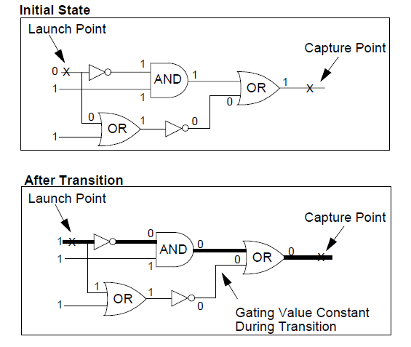
Robust detection example
The gating value at the second OR gate was able to retain the proper value for detection during the entire time from launch to capture events.
Notes:
FastScan detects a path delay fault with three kinds of test: a robust test, a non-robust test, or a functional Test。Robust detection occurs when the gating inputs used to sensitize the path are stable from the time of the launch event to the time of the capture event. it is the most desirable type of detection and for that reason is the approach FastScan tries first. But its restrictive nature make robust test hard to be used at many paths. We can see from the picture: The gating value at the second OR gate was able to retain the proper value for detection during the entire time from launch to capture events.

Slide 15
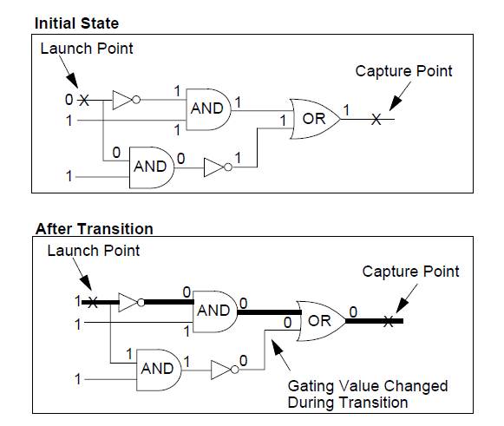
Non-robust detection example
The gating value on the OR gate changed during the 0 to 1 transition placed at the launch point.
Notes:
Here is an example of non-robust detection for a rising-edge transition within a simple path. The gating value on the OR gate changed during the 0 to 1 transition placed at the launch point. Thus, the proper gating value was only at the OR gate at the capture event.

Slide 16
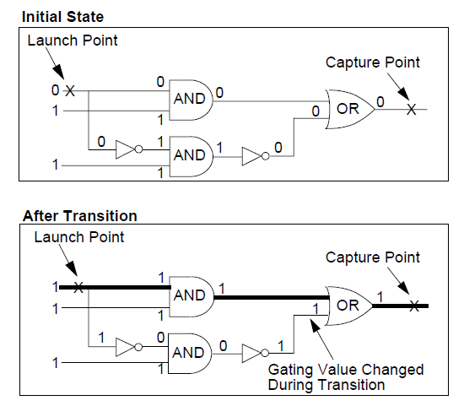
Functional detection example
The gating (off-path) value on the OR gate is neither stable, nor sensitizing at the time of the capture event.
Notes:
And that is a Functional Detection Example. It further relaxes the requirements on the gating inputs used to sensitize the path. The gating (off-path) value on the OR gate is neither stable, nor sensitizing at the time of the capture event. However, the path input transition still propagates to the path output.

Slide 17
Modeling a path delay fault
1. Insert a test model to original circuit
-Insert a test model to the end of target path. We also collect target path’s information to construct our model
2. Apply a vector pair to the target path
- fault activated after applying second vector
- fault effect propagates to and is captured in a destination flip-flop
3. Test model consists of A D flip-flop and several gates
- Add some few logics to the original circuit without increasing the complexity greatly
Notes:
And now I will show how to model a path delay fault: There are three phases to model a path delay fault with a single stuck-at fault. I got this method from Professors Agrawal ’s paper:Generating Test for Delay Faults in Nonscan Circuits. And I make some changes to the test model in latter pair. The first phase is initialization phase: 1. Initialization vectors precede path activation vectors if necessary. ….

Slide 18
Test model for a falling transition
1. Any test that detects the s-a-0 fault at signal OUT1 will detect a slow-to-fall path delay fault on path a-d-e.
2. Our test model is inserted to end of path.

Slide 19
Signal requirement for the inputs of AND gate
Signal requirement | Value
e | 1
d, f, g, h | 0
a | 0
Signal requirement | Value
e | 0
d | 1
a, b, c | 1
Notes:
Here are signal requirements for constructing the AND gate in test model. In this picture, The AND gate is AND2 and AND3. The signal requirement of first vector is shown on the input signals of AND2 while the second vector is shown on AND3. At the first vector, we need to make e as 1. And then we can go backward the target path a-d-e and find the signal requirement for it. Since e is 1, and the NOR1 gate is a nor gate. As a result, d,f,g,h should all be 0. And then a will be 0 . We don’t need to care about b and c since 0 is a controlling value for AND gate. When e needs to be 0, we can do it in the similar way.
We just get the minimum requirement for modeling a path delay fault.

Slide 20
Analysis of the input of FFD
The input of FF1 is initially 0. After we apply the first vector, the output of AND3 will be 0 which propagates signal e to e’. So e’ will be 1 at this time. At the end of first vector, the output of AND2 will come at the input of FF1. This output of AND2 is 1. And then we apply the second vector. The output of AND3 will be 1. Therefore e’ is also 1. The signal value at e’ works like a slow-to-fall fault. And that’s how we model a path delay fault.

Slide 21
Test model for a rising transition
1. Any test detect the s-a-0 fault at signal OUT1 will detect a slow-to-rise path delay fault on path a-d-e.
2.Change the TERM gate from OR gate to AND gate
3. Place a NOT gate at one input of TERM gate.
Notes:
And this is our test model for a rising transition. We change the TERM gate from OR gate to AND gate with a NOT gate. The signal requirement for first test vector is on AND2 while the second requirement is shown on AND3. In a word, the only difference is on TERM gate

Slide 22
Detection test
1. Generate tests for all of the path delay faults.
2. Fault simulation
3. Diagnostic dictionary
Notes:
Our test consists of two parts: one is Detection test and the other is exclusive test. This is the flowchart of our detection test. Firstly, we will Generate test for all of the path delay faults. And then we will do fault simulation and build diagnostic dictionary. If the diagnostic metric is satisfactory, we will just stop. Otherwise, we will start the exclusive test.

Slide 23
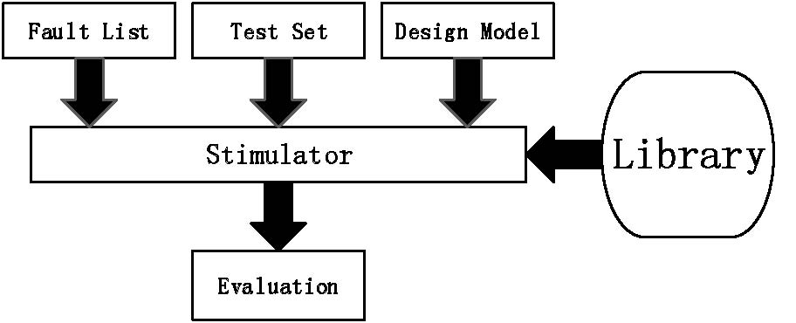
Fault simulation
1. Find detected faults with input test vectors.
2. Group faults with same signature.
3. Calculate diagnostic coverage (DC) .
4. Continue steps 1 through 3 with test vectors until no vectors left.
Fault simulation process
Notes:
Here are four steps that we need to do in fault simulation. Firstly, we need to find detected faults with input test vectors. And then we will group faults with same signature. Thirdly, diagnostic coverage is calculated. And the test will continue until no vectors left. Fault simulation use fault list, test set and design model to make evaluation

Slide 24
Fault dictionary
Fault dictionary keeps the fault signatures to detect the relationship between actual responses and expected results.
A fault dictionary is a matrix where columns represent faults and rows represent tests.
The result in the matrix is 1 when the fault fails the test vector. Otherwise it will be 0.
A pass-fail fault dictionary
Notes:
Fault dictionary keeps the fault signatures in order to be able to quickly detect the relationship between actual responses and expected results when
there appears a fault. A fault dictionary is actually a matrix where columns represent faults and rows represent tests signatures. The result in the matrix is 1 when the fault fails the test vector. Otherwise it will be 0. In Fault dictionary, the faults and expected results of test experiments is reorganized and can be represented in a more compressed form. As the picture shows, it is a pass-fail dictionary which only records pass or fail status of a fault for all applied vectors. Fault 1 fails all 3 test vectors, thus having a signature of 111. The corresponding indexes are shown in the last column of the table. The same index will be assigned when the signature is same.
Row column

Slide 25
Diagnostic dictionary
Given a test pattern, good machine simulation can predict logic values in good circuit at all circuit outputs.
Observing the failures of every test in the dictionary
Faults activated by same set of test patterns will be assigned to the same group.
Notes:
Diagnostic dictionary is actually a fault dictionary that contains faults, tests, and results. We use good machine to build the dictionary. Given a test pattern,……

Slide 26
Diagnostic metrics
$$Fault Coverage=\frac{Number of detected faults}{Total number of faults}$$
Fault coverage (FC) consists of the percentage of faults detected from among all faults that the test pattern set tests—treating untestable faults the same as undetected faults.
Notes:
Here I will…

Slide 27
$$\text{Diagnostic} \text{resolution}\text{ (}\text{DR}\text{)}$$
$$Diagnostic Resolution=\frac{Total number of faults}{Number of signatures}$$
$Diagnostic Resolution$ (DR) gives us the average of faults per group. A perfect DR of 1.0 indicates that all of the faults groups are identified, which means each one fault could represent each equivalent fault class.

Slide 28
$$\text{Diagnostic} \text{coverage}\text{ (}\text{DC}\text{)}$$
$$Diagnostic Coverage=\frac{Total number of detected groups}{Total Number of faults}$$
DC = 1, means that each group has only one fault, which is also a perfect diagnosis.
DC = 1/DR, means that DC is the reciprocal of DR

Slide 29
Analysis of detection test results
If outputs of a pair of path delay faults are not same, these two faults can be distinguished.
Different transition of the path delay faults in the same output of a path can also be distinguished.
Circuit | Diagnostic coverage | Total outputs | Total groups
s298 | 16.87% | 14 | 28
s382 | 13.38% | 21 | 42
s420 | 18.10% | 16 | 32
……. | …….. | ……. | ………
Notes:
After making analysis of detection test results, we can find some things interesting. If outputs of a pair of path delay faults are not same, these two faults can be distinguished. Different transition of the path delay faults in the same output of a path can also be distinguished. Here we calculate the diagnostic coverage of some benchmark circuits. They are always less than 20% that requires us to generate additional test to improve them.

Slide 30
Exclusive test for a pair of faults
(C1⊕C2) = 1
G(X, $y_{insert}$) =${\overline{ y}}_{insert}C1+y_{insert}C2$
Any test that detects a stuck-at 0 fault at the output of XOR gate will distinguish the two faults
$$\frac{∂G}{∂y_{insert}}=G\left(X,0\right)\text{⊕}G\left(X,1\right) \text{=} \text{C}\text{1}\text{⊕}\text{C}\text{2 = 1}$$
XOR gate can be replaced by a multiplexer
Notes:
Here We will show what an exclusive test is. C1 is a circuit with fault 1 while C2 is a circuit with fault2 . If the two faults are different, the output of XOR gate will be 1. Therefore, we can use the conventional tools for detecting a single s-a-0 fault at the output. After making Boolean analysis, this can be transformed to the second picture. We can get the function of G in the second picture. XOR gate can be replaced by a multiplexer.so we can find that
Any fault that detects a s-a-0 or s-a-1 fault at the y_insert will distinguish the pair of faults.

Slide 31
Exclusive test
1. Block 1 represents the fault sets that have already been constituted by conventional detection ATPG system.
2. Exclusive test generation is performed on Block 2.
3. Block 3 is a diagnostic fault simulator. And if all fault pairs have been targeted, we will stop our system.
Notes:
This is the flowchart for the exclusive test. we generate exclusive test . Because …Block1 represents the fault sets that have already been constituted by conventional detection ATPG tools . Exclusive test generation is performed on Block2. Block3 is a diagnostic fault simulator. And if all fault pairs have been targeted, we will stop our system.
,,,

Slide 32
Advantages of exclusive test
Complexity of circuit will not increase a lot: because we just add few logics such as two D flip-lops, several primitive gates to original circuit.
Can make use of existing ATPG algorithms.
Only need to use conventional diagnosis tools to apply test for a single stuck-at fault.

Slide 33
ATPG model
Any test that detect the s-a-0 fault will distinguish these two faults
Notes:
In this picture, our target path is a-d-e and m-k-h-e. we construct two test models in parallel . The gates: AND1, AND3 and flipflop1 will model the path delay fault at path a-d-e. The gates AND2, AND4 and flip-flop2 will model the fault on path m-k-h-e. One input of the two TERM gate is connected to the signal e which is in order to force the output of TERM gates to be 1 at the first vector . Each output of TERM gate will be different after applying the second vector if the two faults are distinguishable fault. Therefore, the s-a-0 fault can then be detected. And it may be detected only at second vector.

Slide 34
ATPG test model
y_insert will be a new added primary input of original circuit
Notes:
These are two target paths a-d-e and m-k-h-e. (飞人后)。。。After we insert the test model to the original circuit. We can then use a multiplexer to replace the exclusive-or gate. y_insert will be a new adding primary input of original circuit. And we will then generate the stuck-at fault at y_insert. If the stuck-at fault can be found, these two faults will be distinguished.

Slide 35
Redundant fault
1. The redundant fault is considered undetectable by the test generator. After the test pattern generator exhausts all patterns, it performs a special analysis to verify that the fault is undetectable under any conditions
2. In this circuit, signal G is always 1, no matter what the values of A, B, and C are. The D stuck at 1 fault is undetectable because the value of G can never change, regardless of the value at D.
An example of redundant fault

Slide 36
ATPG Untestable (AU) fault
Definition:
The ATPG untestable fault class includes all faults for which the test generator is unable to find a test pattern, and yet cannot prove the fault to be redundant.
AU fault in our test model:
generate test for a single stuck-at fault.
Reduce ATPG untestable fault
- remove some constraint (pin constraint)
- change some limitation (sequential depth).
ATPG doesn’t work perfectly!

Slide 37
No test is generated for the stuck-at fault at y_insert
No test can be found to distinguish two slow-to-rise path delay faults.
Notes:
After we apply the test on the y_insert to detect a stuck-at fault, we may find there is no test to be found. Then we manually analyze circuit. Finally we find the reason for it. This figure shows two paths we pick from circuit which have no test for the y_insert.

Slide 38
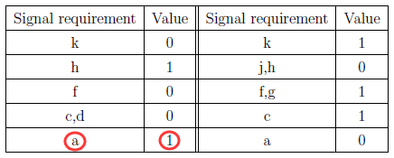
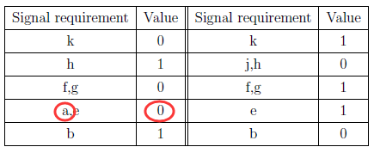
Signal requirement for two paths
path a-c-f-h-k
path b-e-g-h-k
Two slow-to-rise faults with the conflict of signal a at first vector
Notes:
We find the signal requirement for these two paths. Both of the two path delay faults are slow-to-rise fault. There will be a conflict of signal a at first vector. At path a-c-f-h-k, signal a should be 1. But at path b-e-g-h-k, signal a should be 0. At the second vector, there is no such kind of conflict. The response of their second vector cannot distinguish them since they have same response. As a result, we are unable to detect a stuck-at fault after applying second vector.
Are the two faults equivalent fault?

Slide 39
Experimental setup and results
Full-scan benchmark circuits created by DFTadvisor
Generate path definition file
Derive signal requirements from path definition file
Construct test model based on signal requirement
Generate test for stuck-at fault by ATPG
Notes:
We setup our experiment and get some results. We full-scan several benchmark circuits by DFTadvisor ….

Slide 40
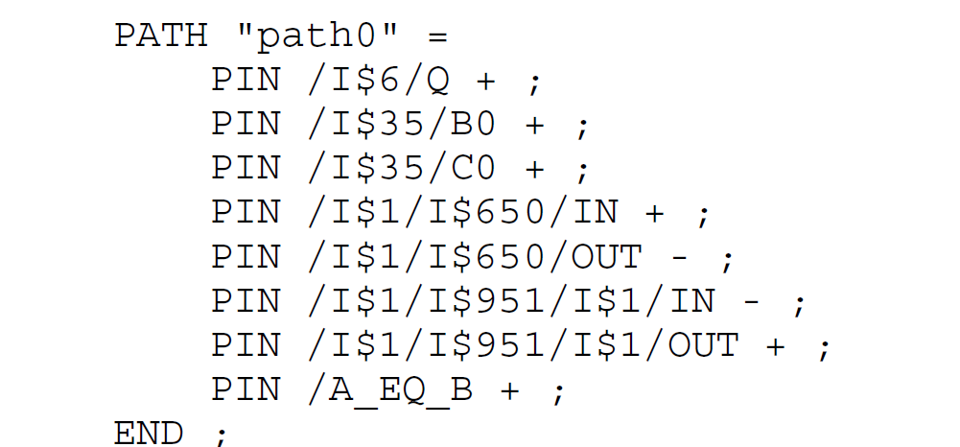
Path definition file
A “+” or “-” indicate the inversion with respect to the launch point. A “+” indicates no inversion while a “-” indicates inversion. The path definition shows start point and end point of a target path.
Any gate that is on the target path is shown in the definition file.
An example of path definition file
Notes:
This is the path definition file..

Slide 41
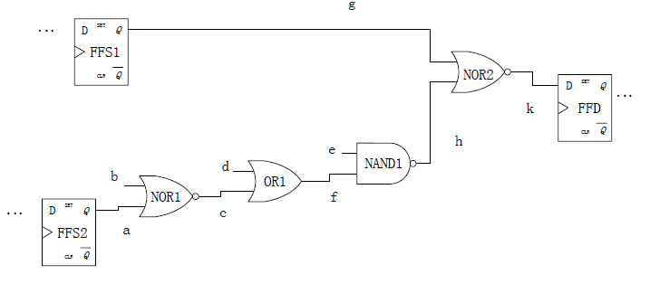
An example of paths in scan circuit
Two target paths. Path 1: g, k. Path 2: a-c-f-h-k

Slide 42
Signal requirements
Our function is based on the signal requirement. These functions will then be used by DFTadvisor. The signal except the output of path can be regarded as the input signal of AND gate in our test model
Signal name | Value
k | 1
g, h | 0
Signal name | Value
k | 0
h | 1
Signal requirement for k to be 1 in path g-k
Signal requirement for k to be 0 in path g-k
Function: y = (~g)&(~h)
Function: y = h
Notes:
After getting the signal requirement of path g-k, we write a function y=(~g)&(~h).

Slide 43
Perl language
Perl is a general-purpose programming language originally developed for text manipulation and now used for a wide range of tasks including system administration, web development, network programming, GUI development, and more.
The Perl language is used to implement our work.
Path definition file will be stored as an array in the program. We also use Perl to write down the function based on signal requirement.

Slide 44
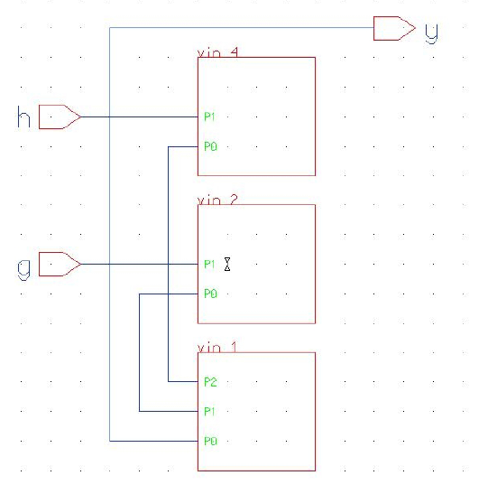
Generate structural model for AND gate
DFTadvisor can help us generate a structural module of the function we previously obtain.
Notes:
DFTadvisor can help us generate a structural module of the function we previously obtain. From the picture, we can see that vin4 and vin2 are NOT gates. Vin1 is AND gate. The picture in right shows what they look like in gate level. The picture in left is a screenshot from adk_daic

Slide 45
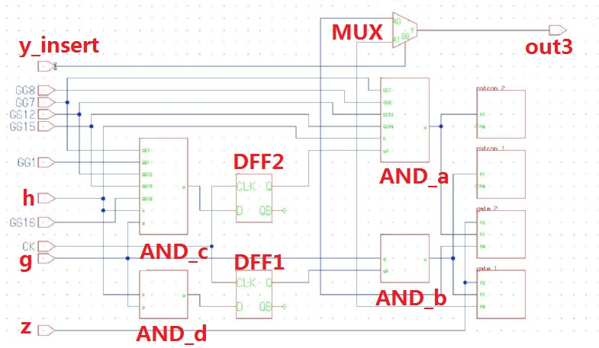
Test model
An example of test model from ADK_DAIC
Notes:
We can see the structure model of our test model from this picture. Signal g, k is on our target path. AND gates a,b,c,d is the four AND gates in our test model. The control signal of mux ---Y_insert will be a new adding primary input in the circuit. And we will detect a s-a-0 or s-a-1 fault at it. The signal z will be connected to the output of the last component in the target path. The signal out3 will feed into the input of destination flip-flop.

Slide 46
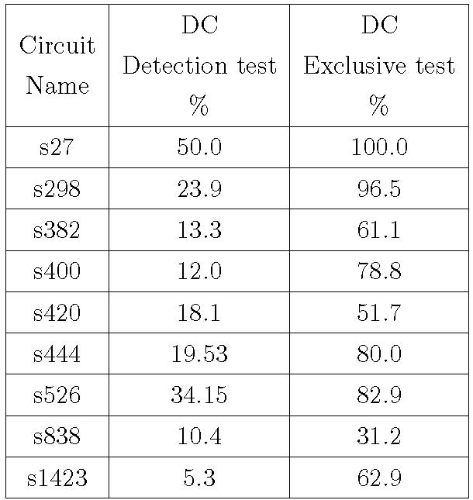
Comparison between detection test and exclusive test.
They all increase greatly after using our test model. We raise s27 from 50% to 100%. This is a perfect test that each set has only one fault. Also, we raise s298 from 23.9% to 96.5%.
Notes:
This is the comparison between detection test and exclusive test.

Slide 47
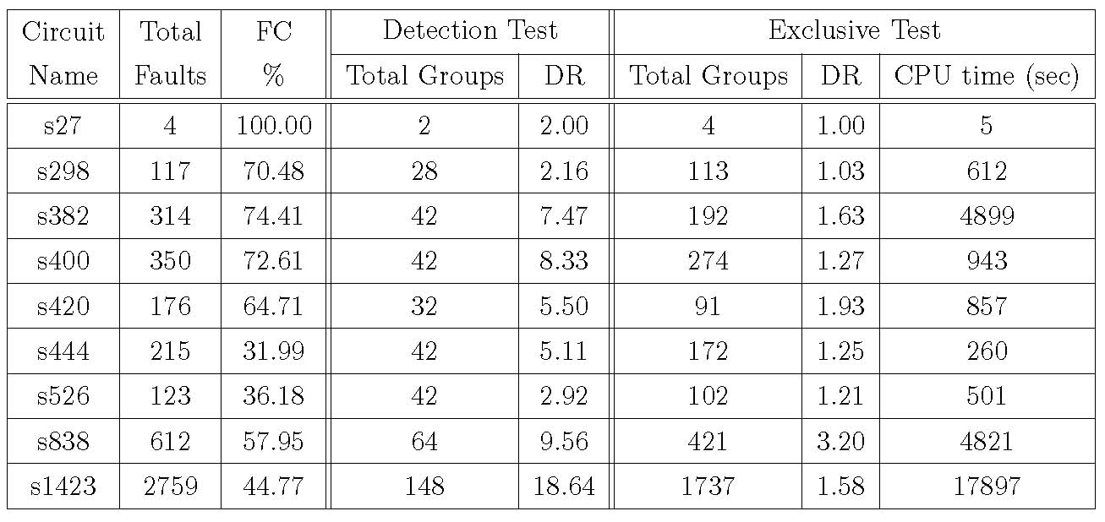
Comparison between detection test and exclusive test.
1. It reveals the Diagnostic Resolution of each circuit.
2. The reason for FC is less than 100% is that redundancy or untestability is not resolved for some aborted ATPG runs.
3. CPU time is also revealed in the last column.
Notes:
The comparison of other related metrics between detection test and exclusive test is shown above. It reveals the Diagnostic Resolution of each circuit. The reason for FC is less than 100% is that redundancy or untestability fault is not identified and some aborted ATPG runs. And the CPU time is also revealed in the last column.

Slide 48
Conclusion
A diagnosis method is proposed to generate exclusive tests to distinguish pairs of path delay faults.
Diagnostic coverage (DC) has been improved by exclusive tests.
Only conventional tools for detecting stuck-at fault are used.
Experimental results shows the Diagnostic Coverage has increased a lot.
Our work can further improve the previous work (Path delay fault diagnosis using path scoring).
Notes:
Here, we make the conclusions.

Slide 49
Future work
Apply test model to non-scan circuits.
Increase capability of ATPG tools to reduce ATPG untestable faults.
Apply our diagnosis method to other fault models such as bridging fault, stuck-open faults, and so on.
We also need to consider a case: An overlap component of two target paths may be blocked by the signal from another path (a path other than these two target paths). In this case, our method will need changes.
Notes:
1.Apply test model on non-scan circuit: Our work focus on application of test model on scan circuit. Actually, the method [18] we previously used for detecting path delay faults with stuck-at faults tool also work in non-scan circuit. Therefore, if we make some changes to our method, it may be also possible to be implemented in non-scan circuit.
2 Increase capability of ATPG tools to reduce ATPG untestable faults: The presence of AU faults shows that the ATPG algorithms for detecting a fault
still need improvement. Moreover, the diagnostic coverage of path delay fault may improve further if the ATPG calculation capability is enhanced.
3. Apply our diagnosis method to other fault models such as bridging fault, stuck-open faults and so on. The behavior of these faults can be mapped to stuck-at fault.

Slide 50
Reference
“Fault diagnosis: Basic Concept.," http://www.pld.ttu.ee/diagnostika/theory/ faultdiagnosis.html.
“John Bardeen: Background, Inventor of Transistor.," http://en.wikipedia.org/wiki/John Bardeen.
“Walter Brattain: Background, Inventor of Transistor.," http://inventors.about.com/od/ bstartinventors/p/Walter Brattain.html.
“co-NP-complete.," http://en.wikipedia.org/wiki/Co-NP-complete .
“Intro of stuck-at fault: Wikipedia.," http://en.wikipedia.org/wiki/Stuck-at fault
M.L. Bushnell and V. D. Agrawal, “Essentials of Electronic Testing for Digital, Memory & Mixed-Signal VLSI Circuits", Boston, Springer, 2000.
“Intro of IDDQ test: Wikipedia.," http://en.wikipedia.org/wiki/Iddq testing.
“Intro of NP-complete problems: Wikipedia.," http://en.wikipedia.org/wiki/NP-complete#NP-complete problems.
“Intro of Polynomial Time: mathworld," http://mathworld.wolfram.com/PolynomialTime.html.
“Intro of Turing machine: Stanford Encyclopedia,” http://plato.stanford.edu/entries/turing-machine.
“Description of UUT: examples, definitions.," http://www. vlsiencyclopedia.com/2012/12/ testbench.html.
V. D. Agrawal and K. K. Saluja, “Antitest, Exclusive Test, and Concurrent Test", Unpublished Manuscript, February 22, 2004, pp. 1--6.
“Definition and Examples of Karnaugh Maps.,” http://www.facsta.bucknell.edu /mastascu /elessons/ Logic/Logic3.html

Slide 51
References, Continued
“Mentor Graphic Scan and ATPG Process Guide (DFTAdvisor, FastScan and FlexTest)", August , 2007
M. J. Y. Willaims and J. B. Angell, “Enhancing Testability of Large-Scale Integrated Circuits via Test Points and Additional Logic", IEEE Trans. on Computers, vol. C-22, no. 1, Jan 1973, pp. 46--60.
P. Agrawal, V. D. Agrawal, and S. C. Seth, “Generating Tests for Delay Faults in Nonscan Circuits", IEEE Design & Test of Computers, vol. 10, March 1993, pp. 20--28.
“Description of pass-fail dictionary.," http://www.eng.auburn.edu/agrawvd /THESIS/ZHANG/ dissertion_yu 2012.pdf.
“Description of Perl language.," https://www.perl.org/.
“Mentor Graphic Scan and ATPG Process Guide (DFTAdvisor, FastScan and FlexTest)", Mentor Graphics Corporation, August , 2007 .
Y. Lim, J. Lee, and S. Kang, “Path Delay Fault Diagnosis Using Path Scoring", in International SoC Design Conf, 2008, pp. 199--202.
L. Zhao, “Net Diagnosis Using Stuck-at and Transition Fault Models" ,Master's thesis, Auburn University, ECE Department, December. 2011.

Slide 52
Thank you! Questions?

